Slide 1

Brought to you by: The Transistor

Slide 2


About us, and why we're here.
Zack
Aaron
We're both active members a hackerspace in provo, The Transistor.

Slide 3
About us, and why we're here.
I have no experience using Arduinos. So I've enlisted the help of Aaron, a fellow member at The Transistor that knows what he's doing with arduinos.
Notes:
maybe you want to put this in the comments? that way what
potatoes

Slide 4
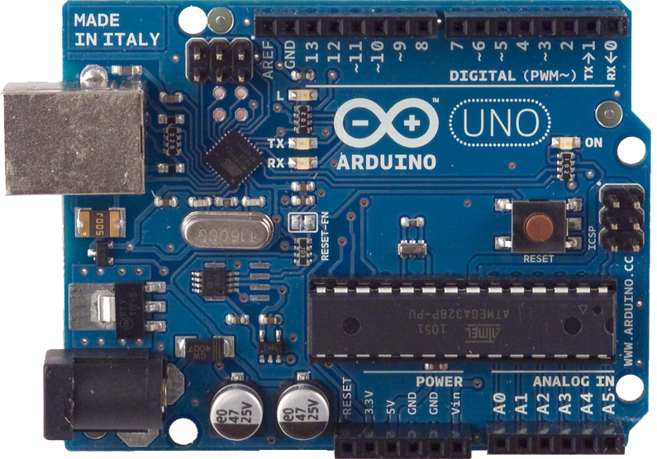
Basic overview of the Arduino platform

Slide 5
The Arduino platform
IDE (programming environment)
C/C++ microcontroller libraries
Dev board built around Atmel ATmega series microcontrollers.
Notes:
Typically, when people think of the arduino, the tendency is to think just of the board itself, but arduino is much more

Slide 6
Who should use Arduino?
Everybody!
Notes:
What demographic is this product after?
I started going through all the people that would benifit from the arduino, but I realized that it's
Everyone!
I personally consider the arduino the best way to learn and really understand principles of programming,
especially good for kinesthetic learners, as you immediately see the results of your code.
It's really robust, I've put 12 volts through it before, shorted pins, I haven't killed one yet

Slide 7
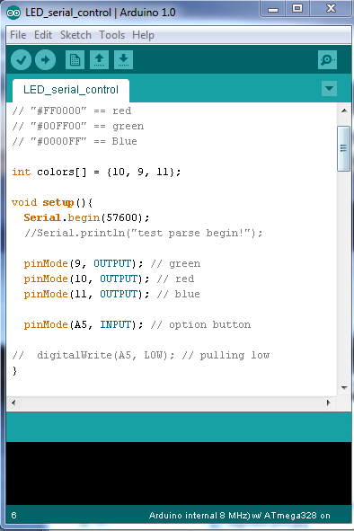
IDE
Written in Java
Simple
Handles compiling and uploading sketches automatically
Notes:
Written in java, presumably for compatibility reasons, it takes care of all the compiling/programming
Easy to work with, but also very basic. Eventually you're going to want to use an external editor.
Here's where you write your code, it's very basic,

Slide 8
I/O
Digital I/O: 14 (of which 6 provide PWM output)
Analog Input: 6
Notes:
The arduino uno, (their primary model) you're provided 14 I/O pins, these are pins that can be used for outputing a signal, or reading one.
They're just on or off.
The analog pins are used to measure from sources that have a varying voltage.
in case someone has any questions about other specs:
DC Current per I/O Pin 40 mA
DC Current for 3.3V Pin 50 mA
Flash Memory 32 KB (ATmega328) of which 0.5 KB used by bootloader
SRAM 2 KB (ATmega328)
EEPROM 1 KB (ATmega328)
Clock Speed 16 MHz

Slide 9
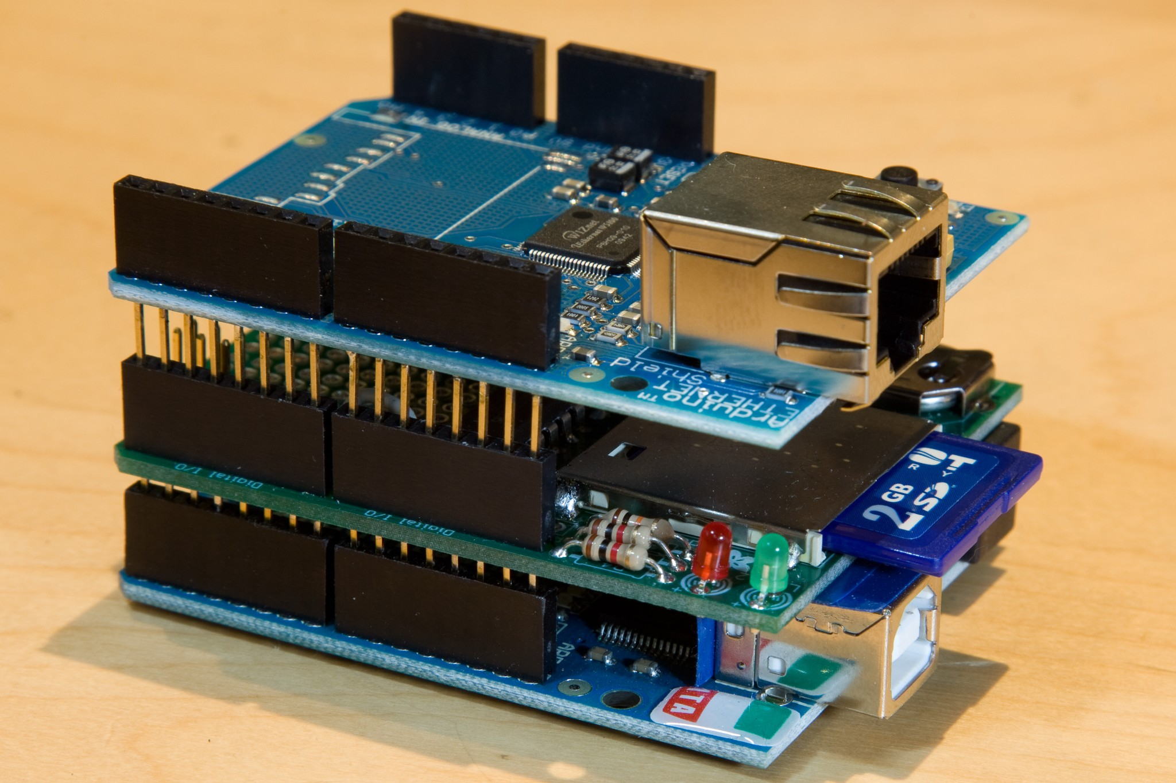
Shields
Shields are boards containing various components that allow you to easily extend the functionality of the Arduino
Notes:
There are a ton of shields out there, and

Slide 10
Language
Based on Wiring
Syntactically similar to C++
// will run at the beginning of sketch, only once
void setup(){
// setup stuff here
}
void loop(){
// infinite loop
}
Notes:
With the arduino libraries, it's really easy to do common things

Slide 11
Language - common functions
Digital I/O:
pinMode()
digitalWrite()
digitalRead()
Analog I/O:
analogReference()
analogRead()
analogWrite() - PWM
Notes:
With the arduino libraries, it's really easy to do common things

Slide 12
Language - blink an LED
// Pin 13 has an LED connected on most Arduino boards. // give it a name: int led = 13; // the setup routine runs once when you press reset: void setup() { // initialize the digital pin as an output. pinMode(led, OUTPUT); } // the loop routine runs over and over again forever: void loop() { digitalWrite(led, HIGH); // turn the LED on (HIGH is the voltage level) delay(1000); // wait for a second digitalWrite(led, LOW); // turn the LED off by making the voltage LOW delay(1000); // wait for a second }
Notes:
With the arduino libraries, it's really easy to do common things

Slide 13
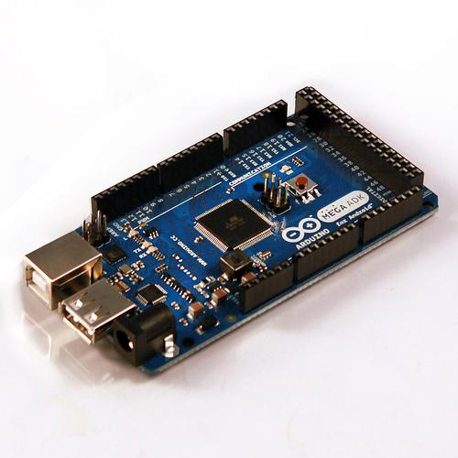
Android ADK
Android Accessory Development kit
Uses Arduino core libraries
Supports Android 2.3.4+
Notes:
I wanted to mention this, as it's very relevent to the event today

Slide 14
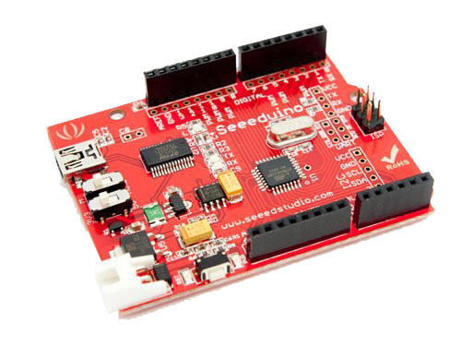
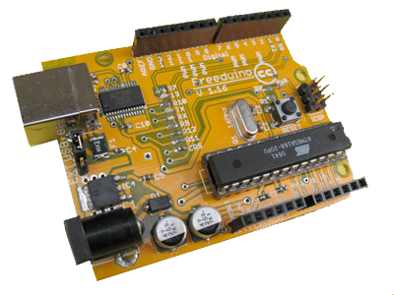
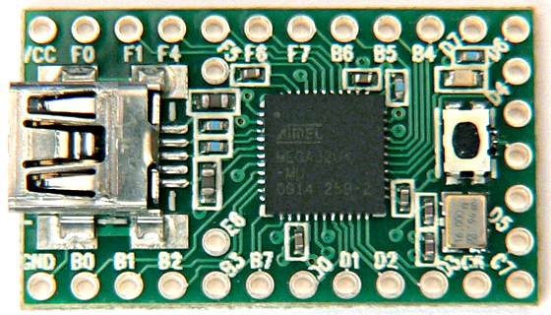
Arduino compatible dev boards
Freeduino
Teensy
Seeeduino

Slide 15
Open Source projects utilizing Arduino
Amblone (ambient display lighting system)
Grbl (CNC project)
Ardupilot
arducopter
WSDL (Weather Station Data Logger)
RepRap (3D printer)

Slide 16
Let's take a look at one of those projects~!!!!!!

Slide 17
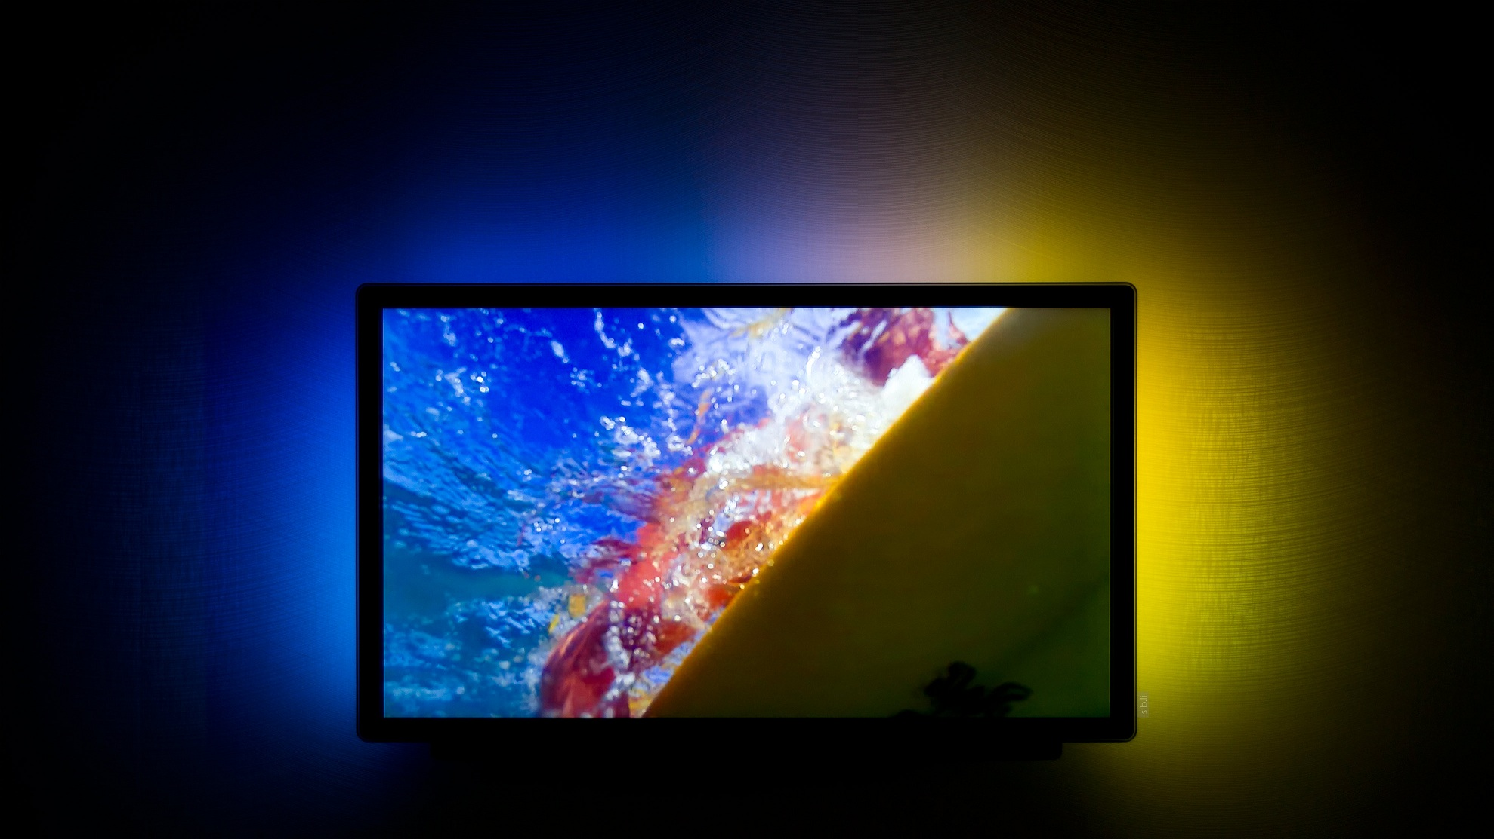
Amblone
>>Philips Ambilight.
Photo by Stephan Legachev.

Slide 18
Amblone
>>Philips Ambilight.
>>Amblone is an open source project that is a clone of Philips Ambilight.

Slide 19
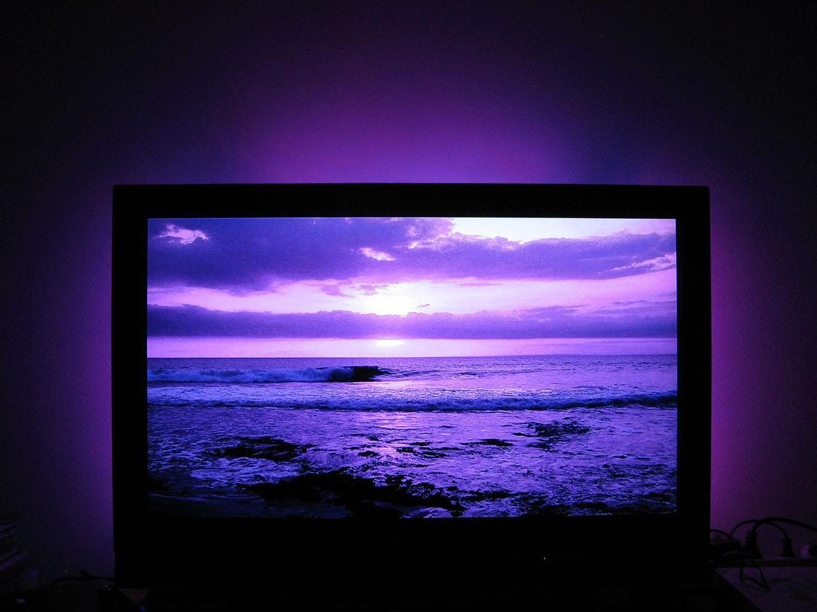
Amblone
>>And this is what Amblone looks like.
Photo taken from amblone.com

Slide 20
Materials needed for Amblone
>>Arduino Mega, Uno, Duemilanova, or other Arduino compatible development boards.
>>RGB LEDs
>>Resistors
>>USB cable
>>Amblone software
>>Soldering Iron
>>Transistors
Notes:
Why is this here? It's not exactly central to the talk

Slide 21
How Amblone works
>>Host side software takes the average of the colors on regions that you specify.
>>The Arduino takes the average screen color for the given regions and then takes care of the all the gritty PWM work.

Slide 22
Practical Applications with Arduinos
>>Weather Station.
>>TF2 indicator lights.
>>Blinkin Lights :p (network traffic indicator)
>>Flight Computer.
>>Magic the Gathering Life Counter.
>>Entry Door control.
>>Spectrum Analyzer.
>>Whatever your imagination can come up with.
Notes:
we were going to have the MTG counter here, but ran into technical difficulties last night

Slide 23
Now let's take a look at some alternative development/prototyping platforms.

Slide 24
Alternative Developer/Prototyping Boards.
>>Raspberry Pi $25/35
>>Beagle Board $89/149
>>terasIC DE0-Nano $79
>>TI Launchpad $6~15

Slide 25
Questions

